Slide 1

Introduction to Operating Systems CS/COE 1550
Spring 2020-2021
Sherif Khattab
ksm73@pitt.edu
(Some slides are from Silberschatz, Galvin and Gagne ©2013)

Slide 2
Announcements
Upcoming deadlines:
3/19: Homework 8
3/26: Lab 3
4/2: Project 3 (Virtual Memory Simulator)
Tophat questions due one week after each lecture

Slide 3
Last Lecture …
Page Replacement Algorithms
Second Chance
CLOCK
LRU
Aging
NFU
Working Set
WS-CLOCK

Slide 4
Muddiest Points (1/2)
Working Set algorithm
Another run through of working set, still hazy on what it is trying to do
In the working set page replacement algorithm, what page from the working set is selected to be evicted if the evicted page has to come from the working set?
the graph for determining how big the working set is
What specifically does the shift register contain? Is it an address to an array containing the k most recently used pages or is it the array itself?
For the working set page replacement algorithm, I got lost in the trace. What does "remember the smallest time" mean? Also, is reading through the page table done every clock cycle or every page reference?
demand paging in working set
Is there any overlap in working sets between processes?
LRU
Maybe one more run through of the LRU algorithm. Seemed to be the hardest one to visualize.
The counter implementation of LRU was the most confusing for me. I believe that I understand the Linked List implementation, but the hardware level counter implementation was hard for me to grasp
Difference between LRU and NFU

Slide 5
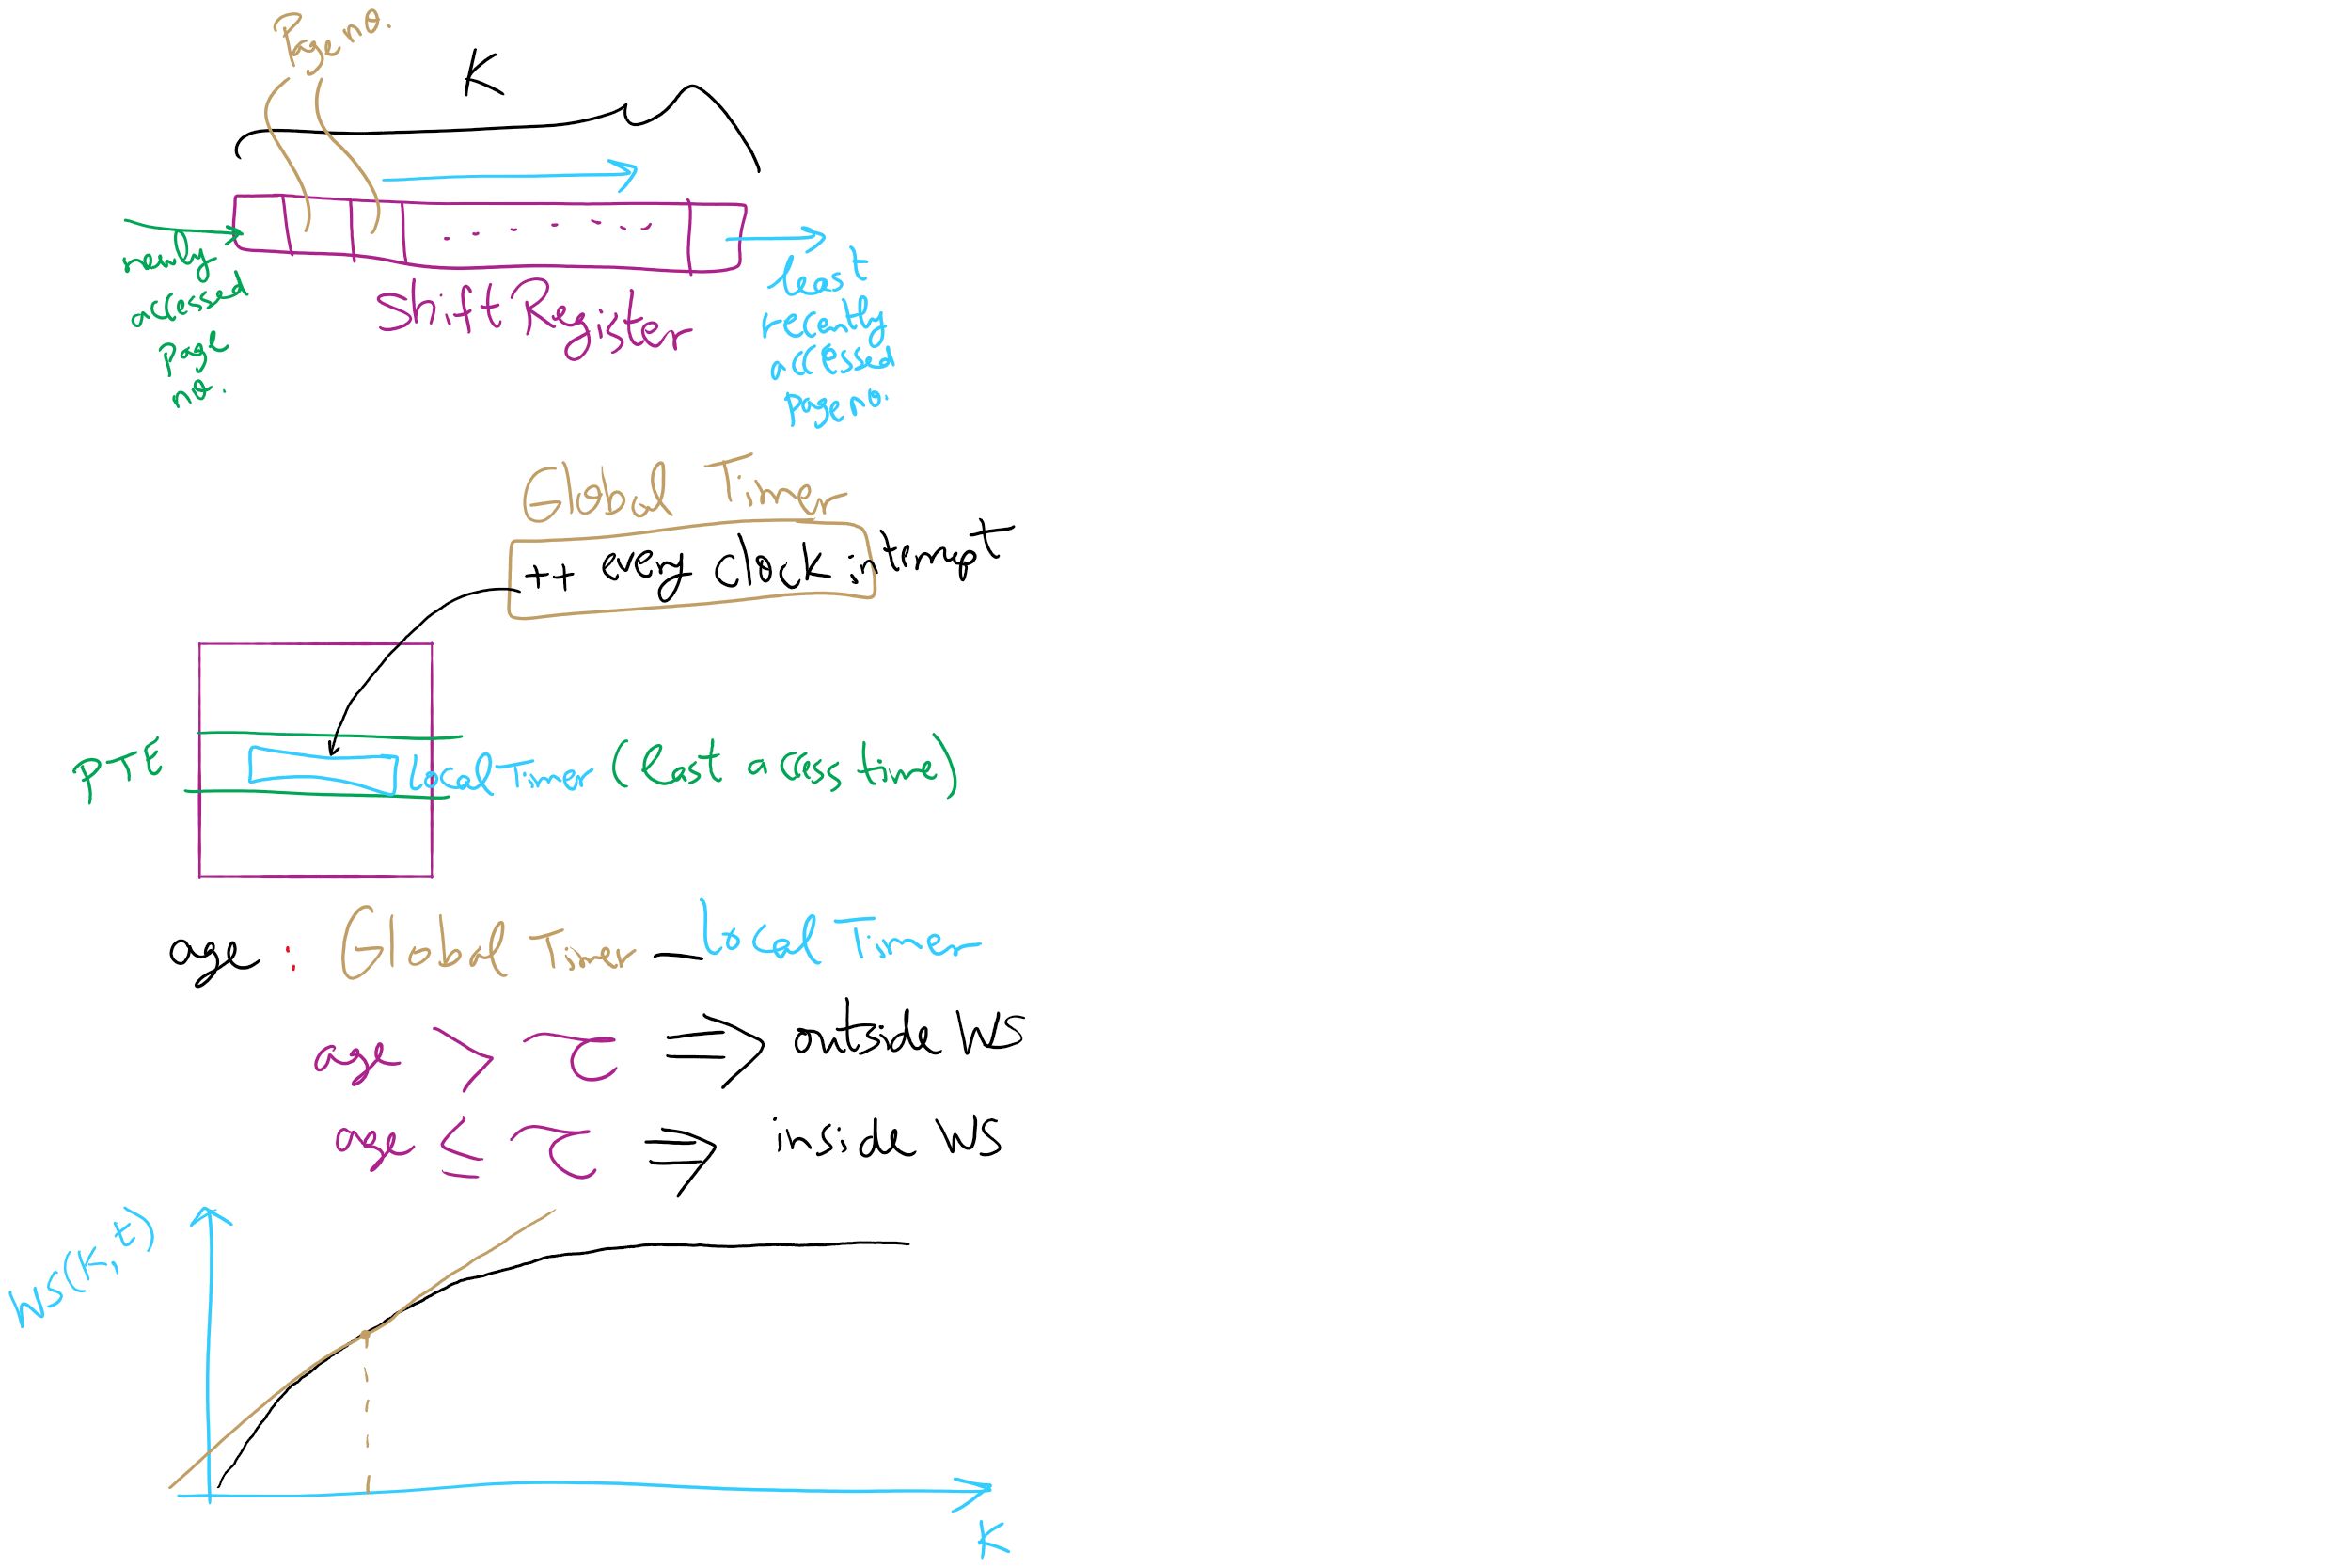
Working Set Algorithm

Slide 6
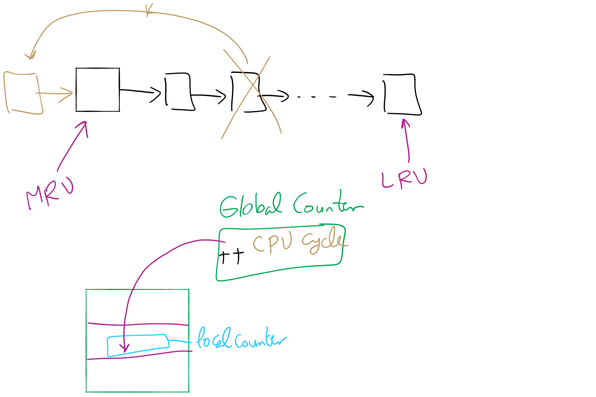
LRU

Slide 7
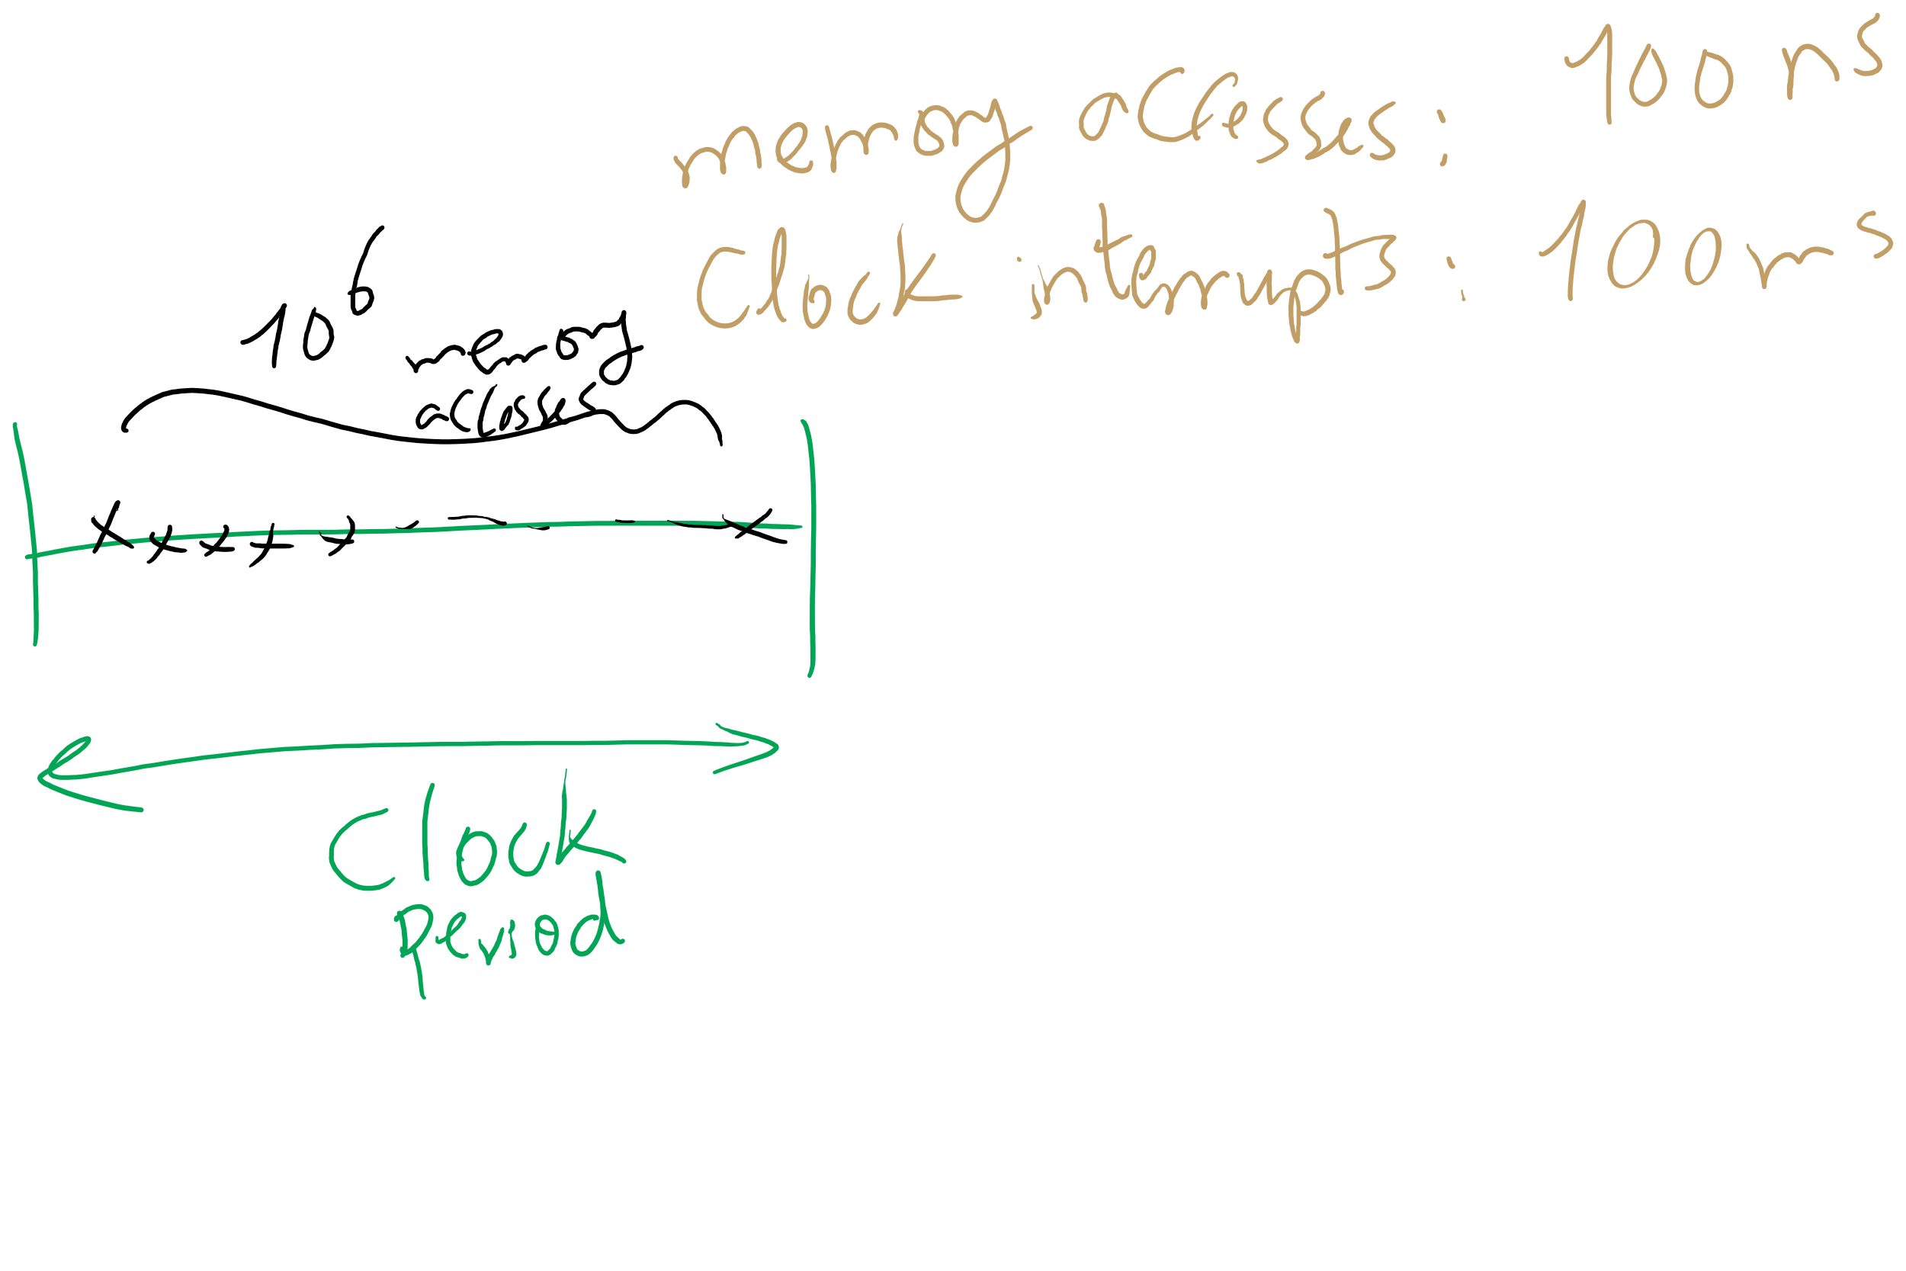
NFU

Slide 8
Muddiest Points (2/2)
What is the dirty bit, and how do you know when it is cleared when doing the algorithm analysis
reviewing the differences between algorithms again
Calculating the number of PTEs are needed for a process (hw 8 question 11)
I'm behind due to midterms this week, but I'll catch up over the weekend.
When is working set best to use?
Working through page modeling
what does is mean that a list of references is "artificial”
i think running through the page replacement algorithms again and tracing them again would be helpful.
Just going over the modeling we did at the end of lecture again would be helpful
What is the hard disc used for as opposed to RAM?

Slide 9
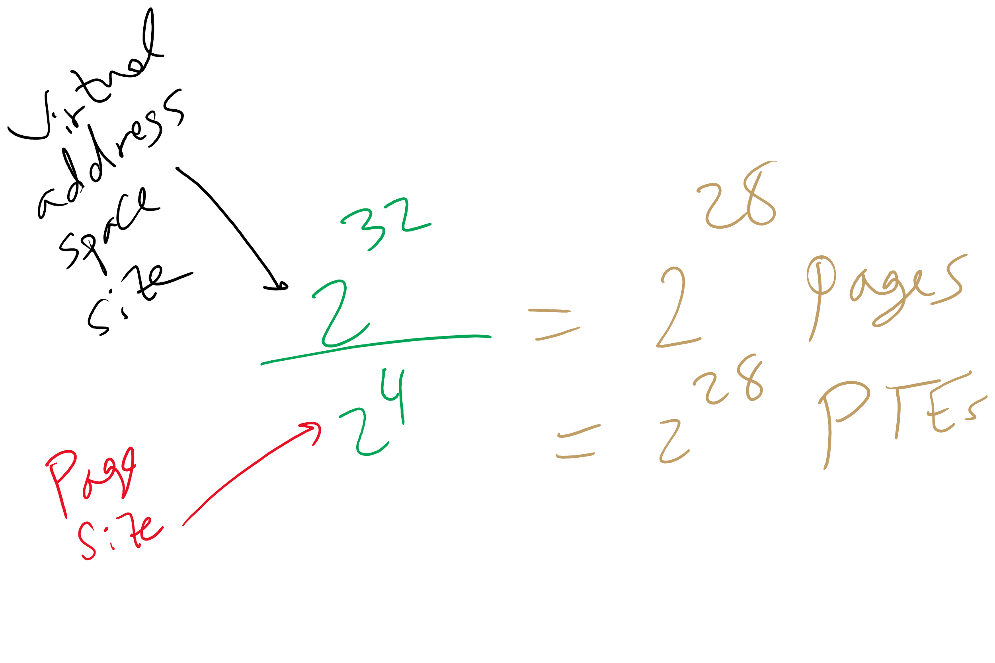
HW 8 Q11

Slide 10
Today’s Agenda …
Address Translation

Slide 11
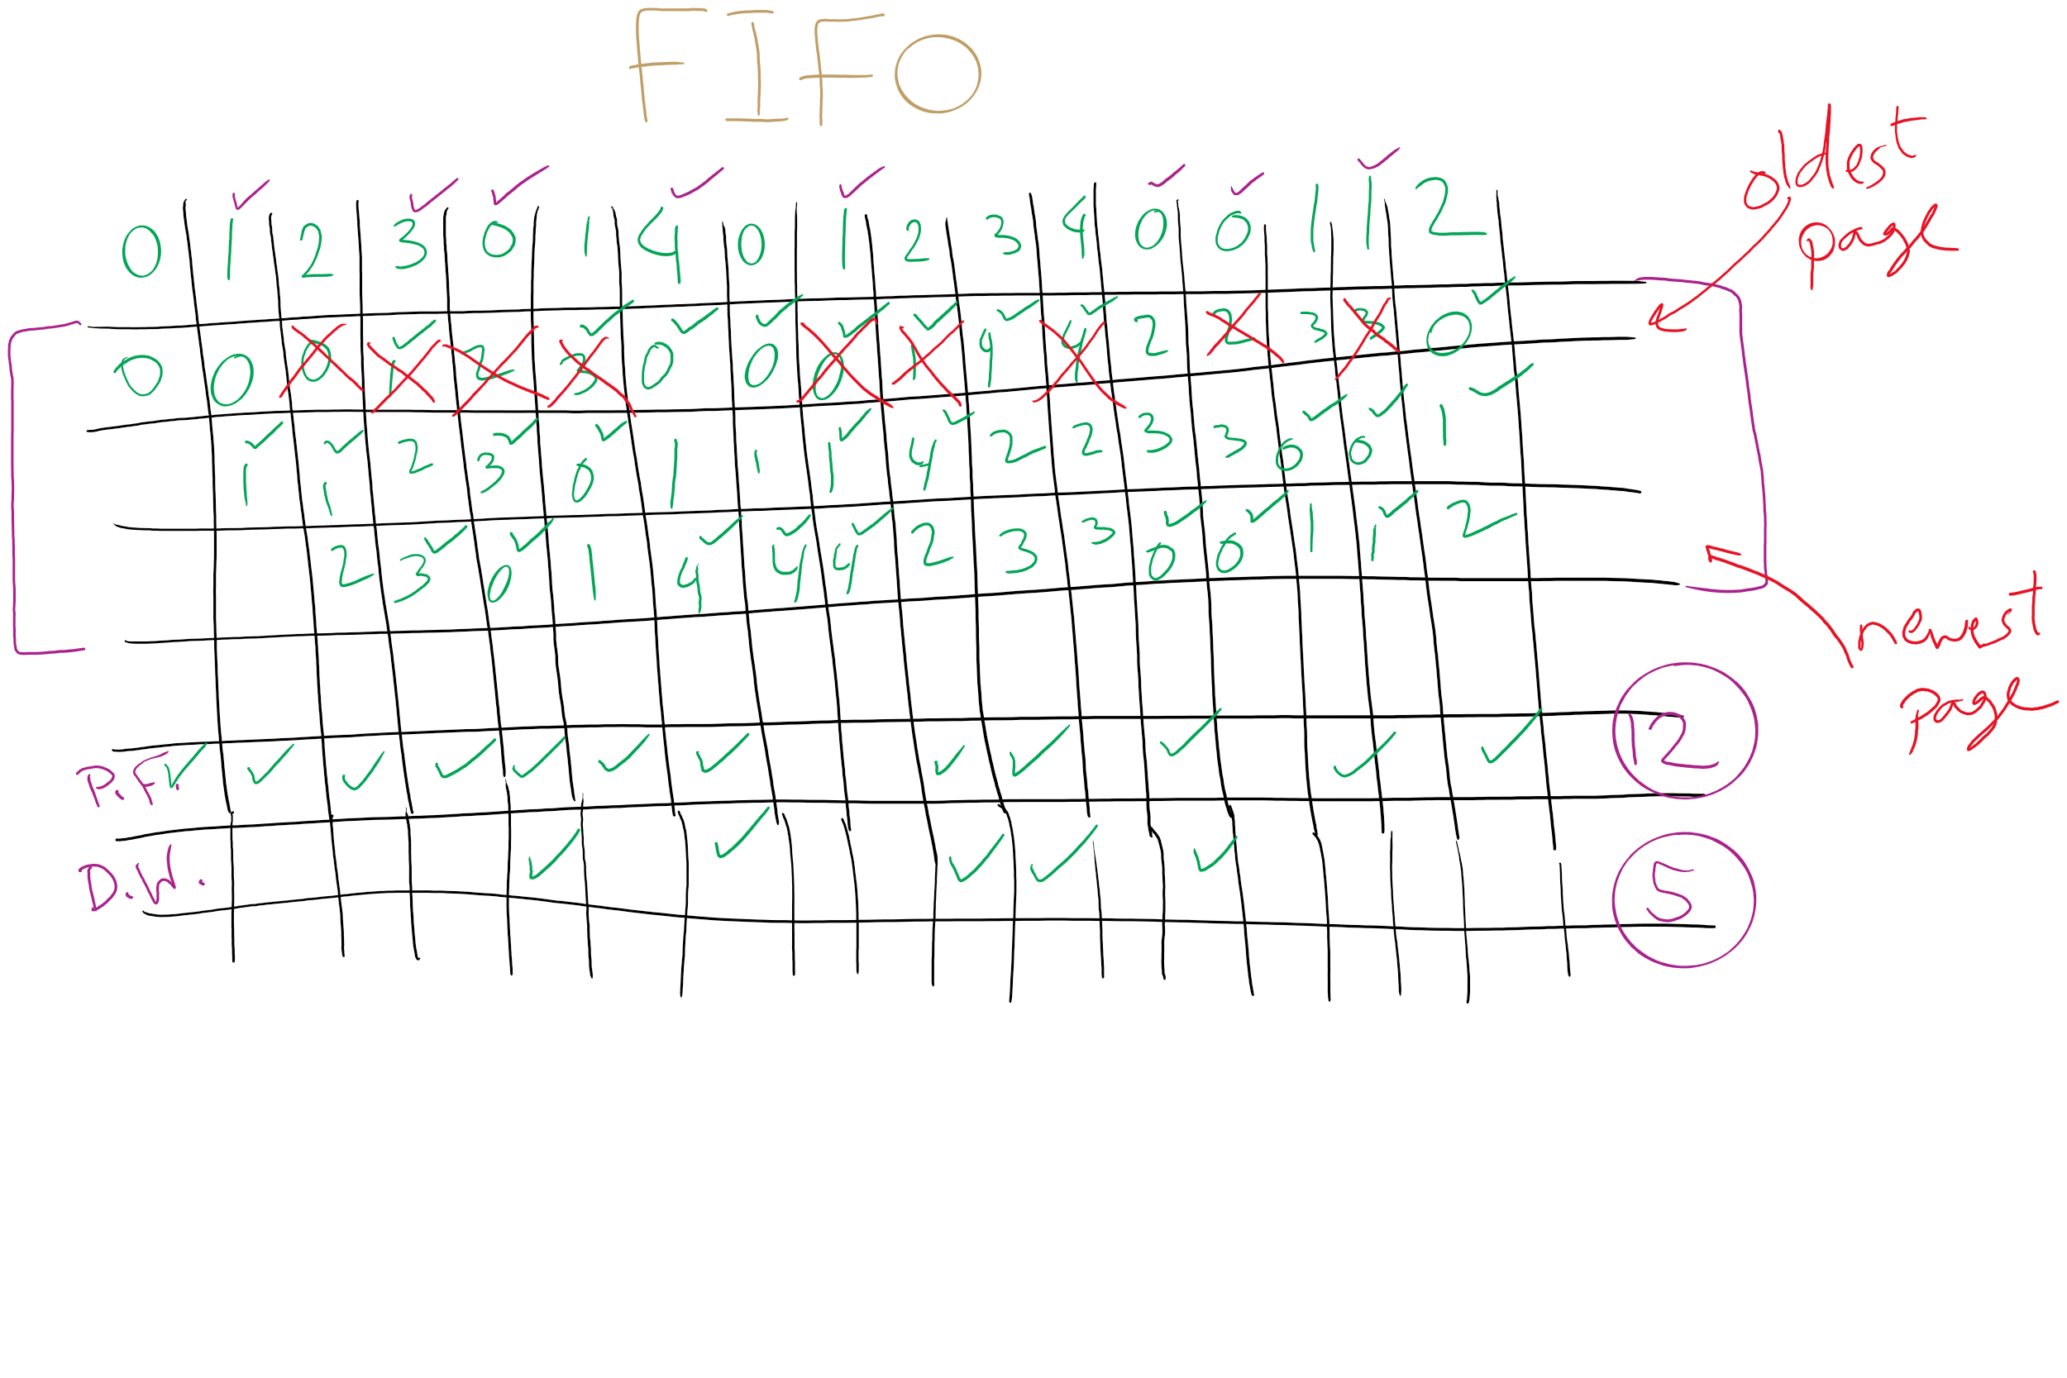
FIFO with 3 frames

Slide 12
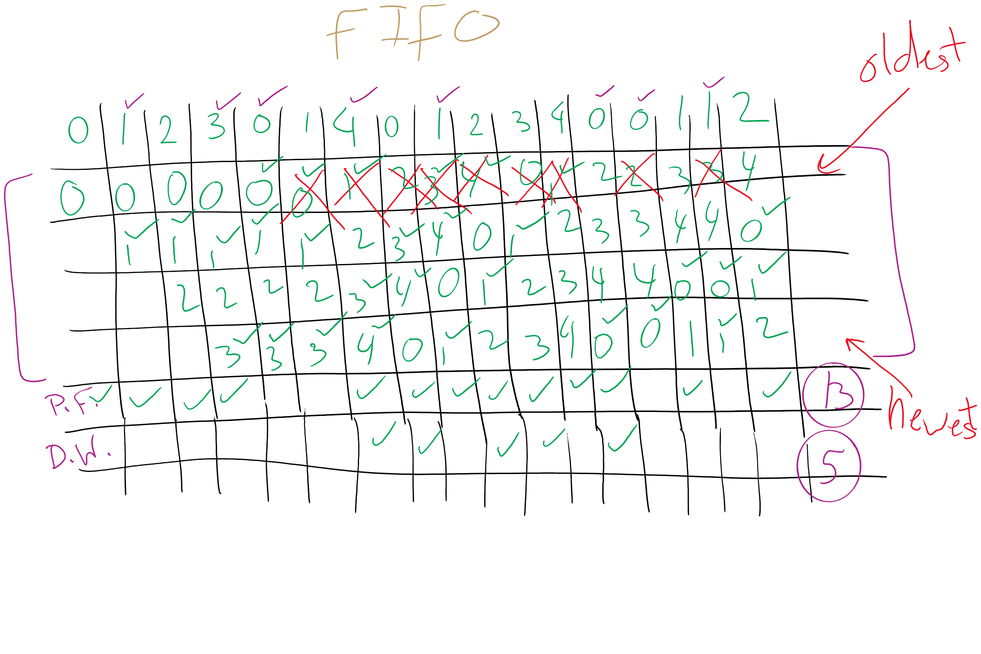
FIFO with 4 frames

Slide 13
Belady’s anomaly
Reduce the number of page faults by supplying more memory
Use previous reference string and FIFO algorithm
Add another page to physical memory (total 4 pages)
More page faults (10 vs. 9), not fewer!
This is called Belady’s anomaly
Adding more pages shouldn’t result in worse performance!
Motivated the study of paging algorithms
Page referenced |  | 0 | 1 | 2 | 3 | 0 | 1 | 4 | 0 | 1 | 2 | 3 | 4
Youngest page |  | 0 | 1 | 2 | 3 | 3 | 3 | 4 | 0 | 1 | 2 | 3 | 4
 |  |  | 0 | 1 | 2 | 2 | 2 | 3 | 4 | 0 | 1 | 2 | 3
 |  |  |  | 0 | 1 | 1 | 1 | 2 | 3 | 4 | 0 | 1 | 2
Oldest page |  |  |  |  | 0 | 0 | 0 | 1 | 2 | 3 | 4 | 0 | 1

Slide 14
Modeling more replacement algorithms
Paging system characterized by:
Reference string of executing process
Page replacement algorithm
Number of page frames available in physical memory (m)
Model this by keeping track of all n pages referenced in array M
Top part of M has m pages in memory
Bottom part of M has n-m pages stored on disk
Page replacement occurs when page moves from top to bottom
Top and bottom parts may be rearranged without causing movement between memory and disk

Slide 15
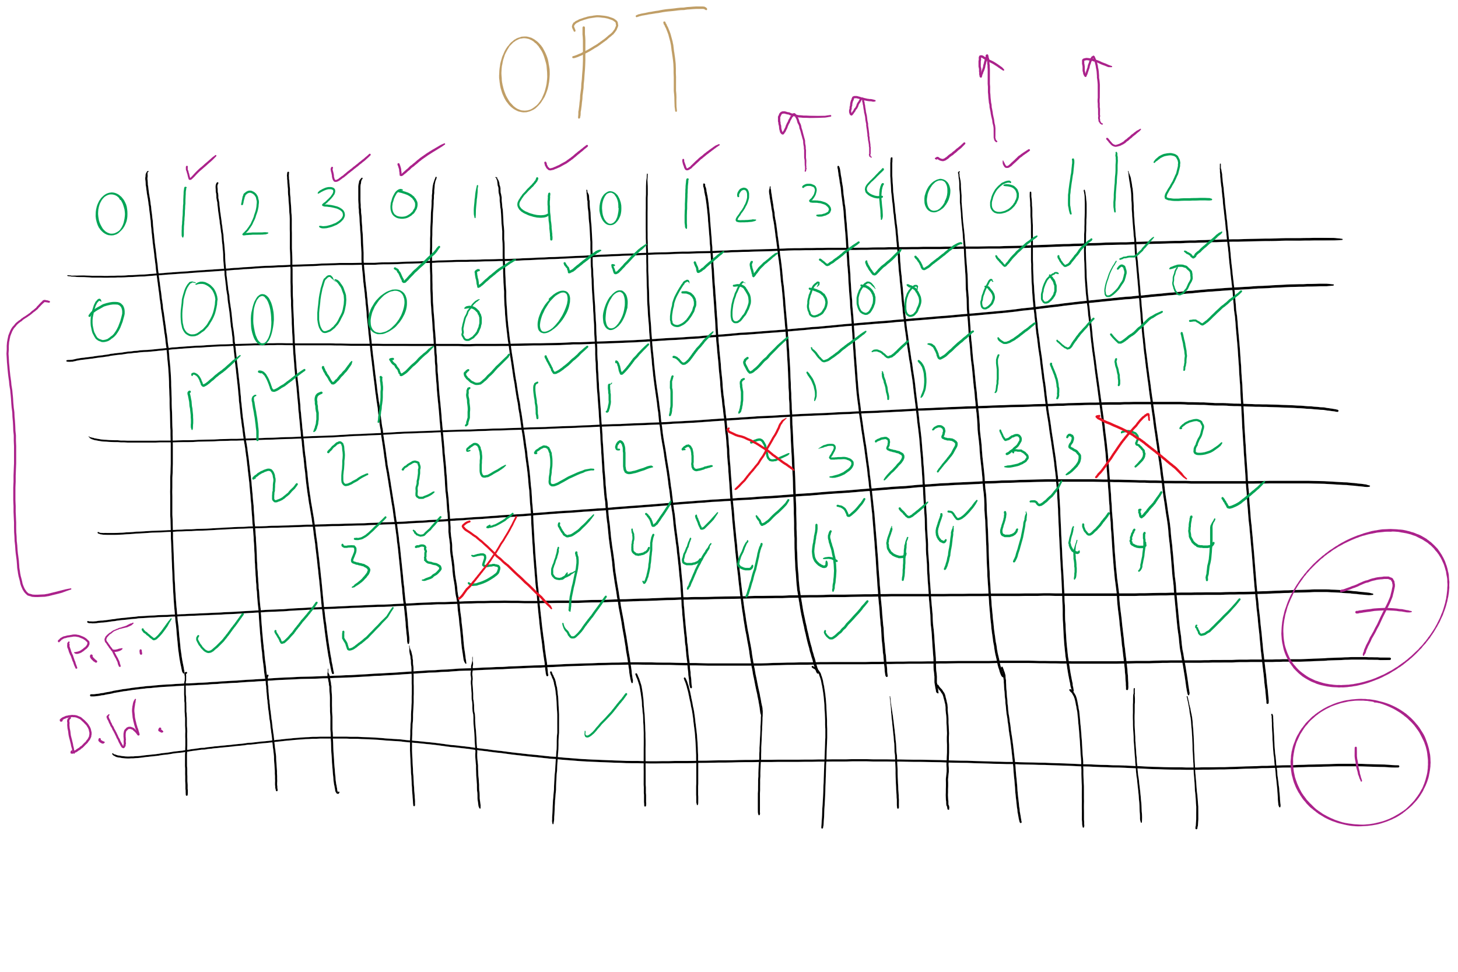
OPT

Slide 16
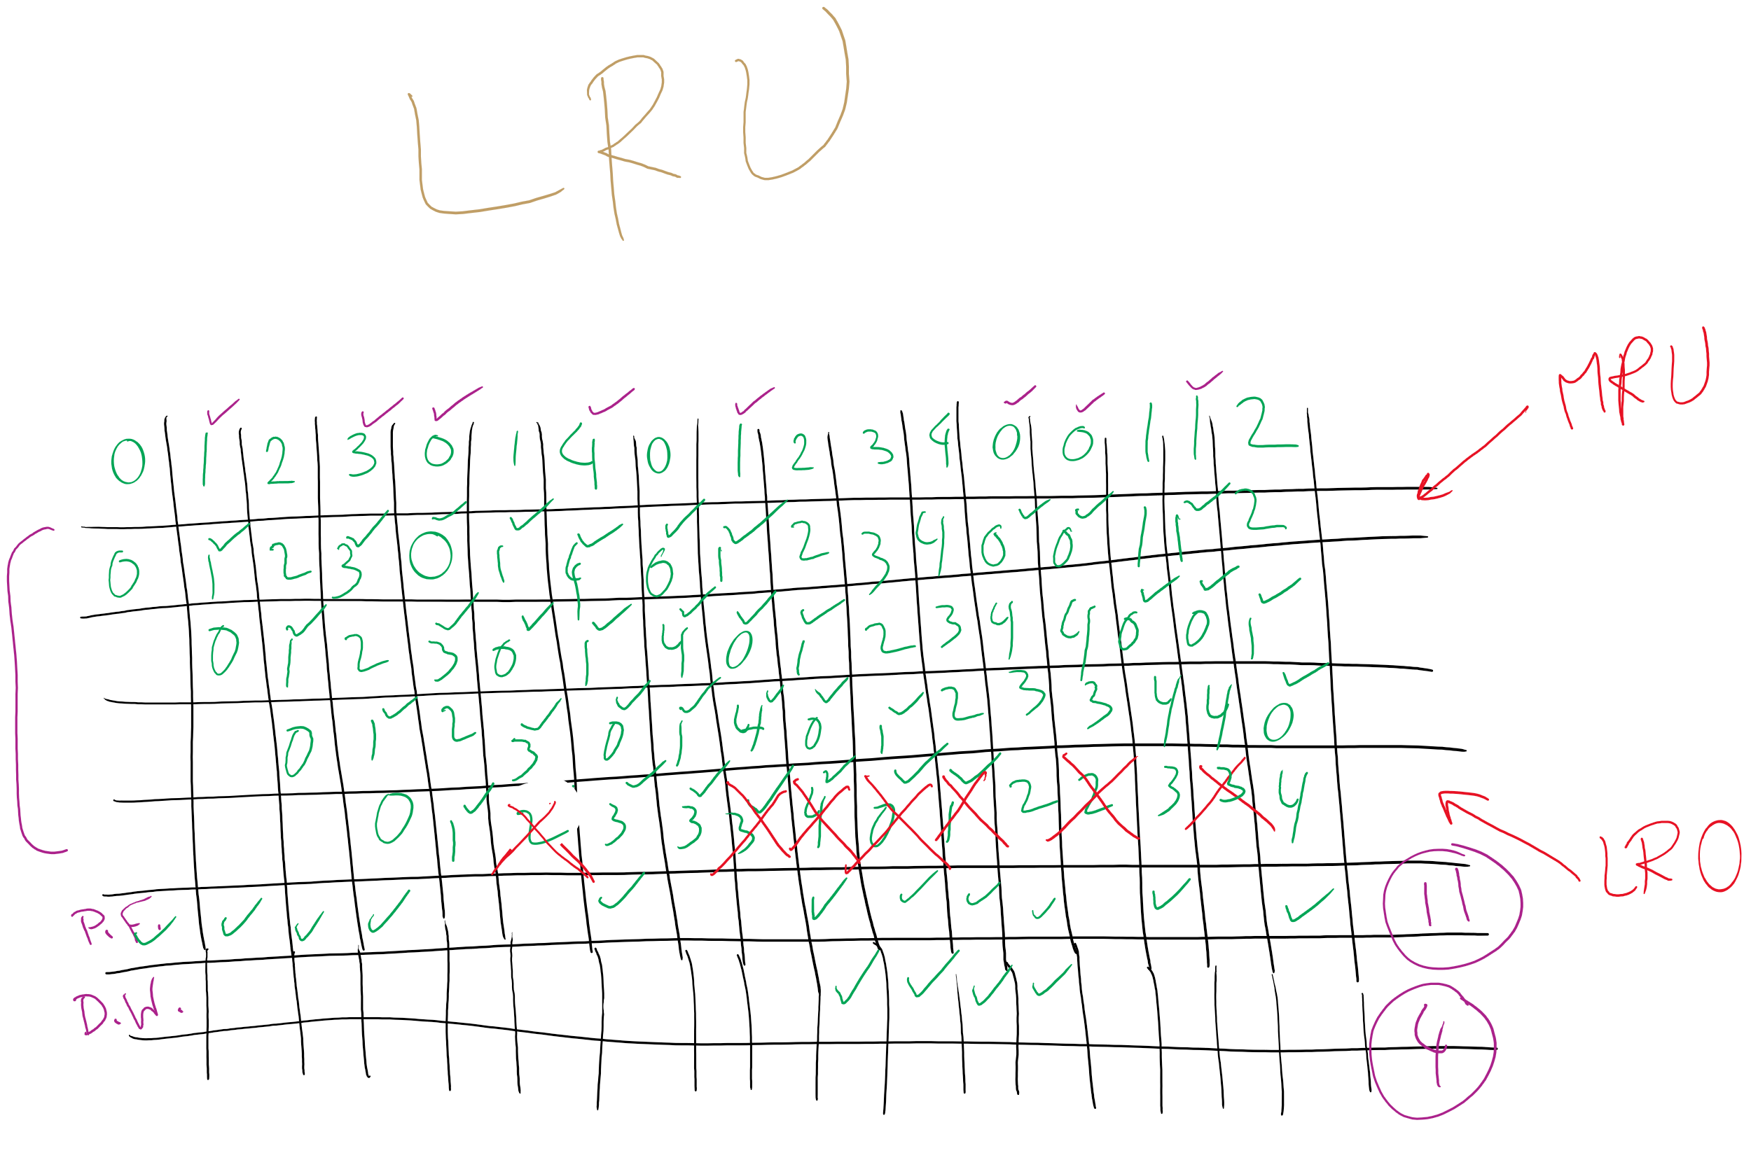
LRU

Slide 17
Example: LRU
Model LRU replacement with
8 unique references in the reference string
4 pages of physical memory
Array state over time shown below
LRU treats list of pages like a stack
 | 0 | 2 | 1 | 3 | 5 | 4 | 6 | 3 | 7 | 4 | 7 | 3 | 3 | 5 | 5 | 3 | 1 | 1 | 1 | 7 | 1 | 3 | 4 | 1
 | 0 | 2 | 1 | 3 | 5 | 4 | 6 | 3 | 7 | 4 | 7 | 3 | 3 | 5 | 5 | 3 | 1 | 1 | 1 | 7 | 1 | 3 | 4 | 1
 |  | 0 | 2 | 1 | 3 | 5 | 4 | 6 | 3 | 7 | 4 | 7 | 7 | 3 | 3 | 5 | 3 | 3 | 3 | 1 | 7 | 1 | 3 | 4
 |  |  | 0 | 2 | 1 | 3 | 5 | 4 | 6 | 3 | 3 | 4 | 4 | 7 | 7 | 7 | 5 | 5 | 5 | 3 | 3 | 7 | 1 | 3
 |  |  |  | 0 | 2 | 1 | 3 | 5 | 4 | 6 | 6 | 6 | 6 | 4 | 4 | 4 | 7 | 7 | 7 | 5 | 5 | 5 | 7 | 7
 |  |  |  |  | 0 | 2 | 1 | 1 | 5 | 5 | 5 | 5 | 5 | 6 | 6 | 6 | 4 | 4 | 4 | 4 | 4 | 4 | 5 | 5
 |  |  |  |  |  | 0 | 2 | 2 | 1 | 1 | 1 | 1 | 1 | 1 | 1 | 1 | 6 | 6 | 6 | 6 | 6 | 6 | 6 | 6
 |  |  |  |  |  |  | 0 | 0 | 2 | 2 | 2 | 2 | 2 | 2 | 2 | 2 | 2 | 2 | 2 | 2 | 2 | 2 | 2 | 2
 |  |  |  |  |  |  |  |  | 0 | 0 | 0 | 0 | 0 | 0 | 0 | 0 | 0 | 0 | 0 | 0 | 0 | 0 | 0 | 0

Slide 18
Stack algorithms
LRU is an example of a stack algorithm
For stack algorithms
Any page in memory with m physical pages is also in memory with m+1 physical pages
Increasing memory size is guaranteed to reduce (or at least not increase) the number of page faults
Stack algorithms do not suffer from Belady’s anomaly
Distance of a reference == position of the page in the stack before the reference was made
Distance is ∞ if no reference had been made before
Distance depends on reference string and paging algorithm: might be different for LRU and optimal (both stack algorithms)

Slide 19
Predicting page fault rates using distance
Distance can be used to predict page fault rates
Make a single pass over the reference string to generate the distance string on-the-fly
Keep an array of counts
Entry j counts the number of times distance j occurs in the distance string
The number of page faults for a memory of size m is the sum of the counts for j>m
This can be done in a single pass!
Makes for fast simulations of page replacement algorithms
This is why virtual memory theorists like stack algorithms!

Slide 20
Mapping logical => physical address
Split address from CPU into two pieces
Page number (p)
Page offset (d)
Page number
Index into page table
Page table contains base address of page in physical memory
Page offset
Added to base address to get actual physical memory address
Page size = 2^{d} bytes
Example:
• 4 KB (=4096 byte) pages
• 32 bit logical addresses
2^{d} = 4096
d = 12
32-12 = 20 bits
12 bits
p
d
32 bit logical address

Slide 21
Address translation architecture
page number
Page frame number
Page frame number
page offset
0
CPU
p
d
f
d
1
. . .
0
f-1
1
f
. . .
f+1
p-1
f+2
p
f
. . .
p+1
physical memory
page table

Slide 22
Memory & paging structures
Physical memory
Page frame number
Page 0
6
Page 1
3
0
Page 1 (P1)
Page 2
4
1
Page 3
9
2
Page 4 (P0)
Page 4
2
3
Page 1 (P0)
Free
pages
4
Page 2 (P0)
Logical memory (P0)
Page table (P0)
5
6
Page 0 (P0)
Page 0
8
7
Page 1
0
8
Page 0 (P1)
9
Page 3 (P0)
Logical memory (P1)
Page table (P1)

